Slide 1
Network : Congestion Control
Jae Hyeon Kim

Slide 2
Reference
William Stalling, Data and Computer Communications 10/E, Prentice Hall

Slide 3
Congestion Control
Congestion occurs when the number of packets being transmitted through the network approaches the packet handling capacity of the network
Congestion control aims to keep number of packets below level at which performance falls of dramatically
Data network is a network of queues
Generally 80% utilization is critical
Finite queues mean data may be lost

Slide 4
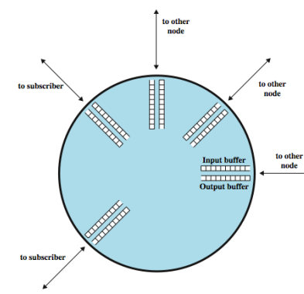
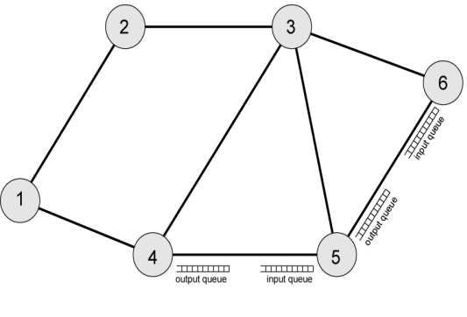
Finite Queues
Queue at a node
Interaction of queues

Slide 5
Effects of Congestion
What typical works on a router
Packets arriving are stored at input buffers
Routing decision made
Packet move to output buffer
Packets queued for output transmitted as fast as possible
Statistical time division multiplexing
If packets arrive to fast to be routed, or to be output, buffers will fill
Can discard packets
Can use flow control : propagate congestion though network

Slide 6
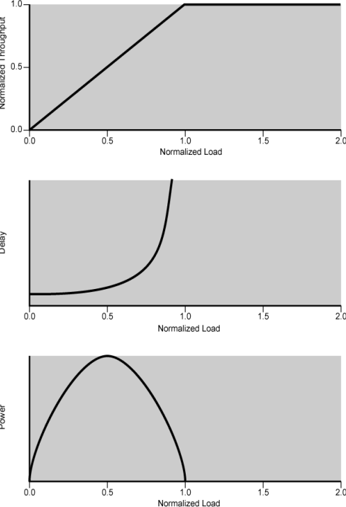
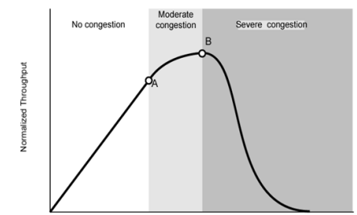
Idel vs. Practical Performance
Practical performance
Ideal assumes infinite buffers and no overhead
But, buffers are finite
Overheads occur in exchanging control msgs
Effects of congestion
With no control

Slide 7
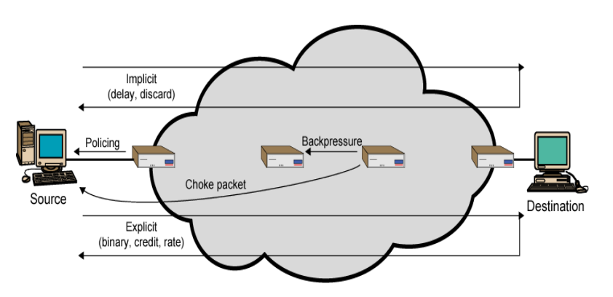
Mechanisms for Congestion Control

Slide 8
Backpressure
If a node becomes congested it can slow down or halt flow of packets from other nodes
Then, other nodes have to apply control on incoming packet rates
Flow restriction propagates backward to sources, which are restricted in the flow of new packets into the network
Can be exerted on the basis on links or logical connections
Can be selectively applied to logical connections so that the flow from one node to the next is only restricted on some connections
Only recently developed for IP

Slide 9
Choke Packet
Control packet
Generated at congested node
Sent to source node
An example is Internet Control Message Protocol (ICMP) source quench packet
From router or destination end system
Source cuts back until it no longer receives quench messages
Message is issued for every discarded packet
Message may also be issued for anticipated congestion
Crude control technique

Slide 10
Congestion Signaling
Implicit congestion signaling
With network congestion, transmission delay increases, and/or packets may be discarded
Source can detect congestion and reduce flow
Effective on connectionless (datagram) networks
Explicit congestion signaling
Network alerts end systems of increasing congestion
End systems take steps to reduce offered load
Backwards : congestion avoidance in opposite direction
Forwards : congestion avoidance in same direction

Slide 11
Explicit Signaling Categories
Binary
A bit set in a packet indicates congestion
Credit based
Indicates how many packets source may send
Common for end to end flow control
Rate based
Supply explicit data rate limit
Nodes along path may request rate reduction

Slide 12
Traffic Management
Fairness
Provide equal treatment of various flows
Quality of Service (QoS)
Different treatment for different connections
Reservations
Traffic contract between user and network
Excess traffic discarded or handled on a best-effort basis

Slide 13
Congestion Control in Packet Switched Networks
Send control packet to some or all source nodes
Requires additional traffic during congestion
Rely on routing information
May react too quickly
End to end probe packets
Adds to overhead
Add congestion info. To packets as they cross nodes
Either backwards or forwards
So, two categories of TCP congestion control
Retransmission timer management
Window management

Slide 14
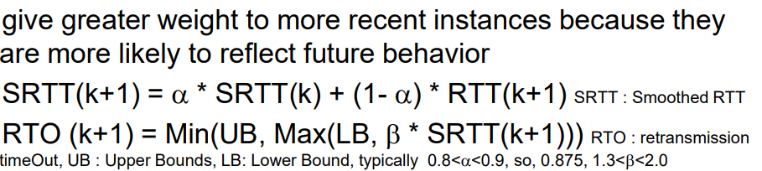
Retransmission Timer Management (1)
As network conditions change, a static retransmission timer is likely to be either too long or too short
All TCP attempt to estimate the current round-trip time and then set the timer to a value somewhat greater than the estimated time
Simple average
Exponential average : RFC 793

Slide 15
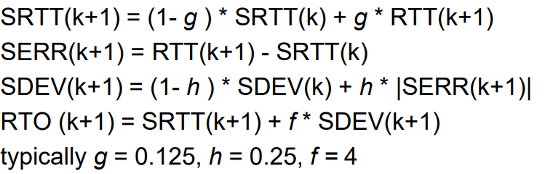
Retransmission Timer Management (2)
Jacobson’s algorithm
RTT exhibits a relatively high variance
With low variance of RTT, RTO is too high, whilst in an unstable environment, β = 2 may be inadequate with unnecessary retrans.
Again, give greater weight to more recent instances because they are more likely to reflect future behavior

Slide 16
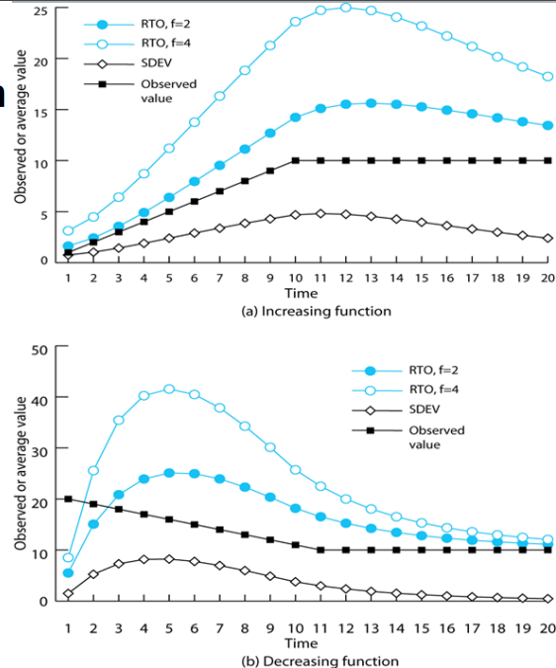
Jacobson’s RTO Calculation

Slide 17
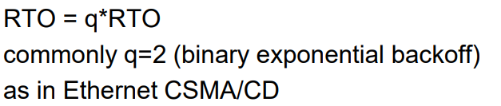
Exponential RTO Backoff
When a TCP sender times out on a segment, it must retransmit that segment
Timeout probably due to congestion, such as dropped packet or long round trip time
Hence, maintaining the same RTO is not good idea
A more sensible policy dictates that a sending TCP entity increase its RTO each time a segment is re-transmitted

Slide 18
Karn’s Algorithm
If a segment is re-transmitted, the ACK arriving may be:
For the first copy of the segment (RTT longer than expected)
For second copy
No way to tell for which one
Do not measure RTT for re-transmitted segments
But calculate backoff when re-transmission occurs
Use the backoff RTO until ACK arrives for segment that has not been re-transmitted

Slide 19

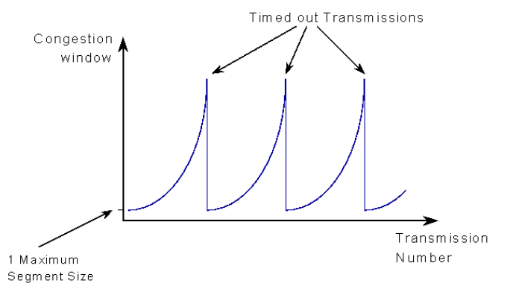
Window Management (1)
The size of sending window can have a critical effect on TCP performance in front of a congestion
Slow start : gradually expanding the window
awnd = MIN[credit, cwnd]
Start connection with cwnd = 1
Increment cwnd by 1 (actually 2) at each ACK, to some max

Slide 20
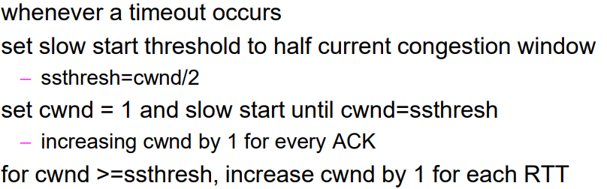
Window Management (2)
Dynamic windows sizing on congestion
Jacobson points out that “it is easy to drive a network into saturation but hard for the net to recover”
With the slow start, cwnd keeps growing exponential until it becomes equal to receiver window (credit)
However, for the congestion, the exponential growth of cwnd may be too aggressive and may worsen the congestion

Slide 21
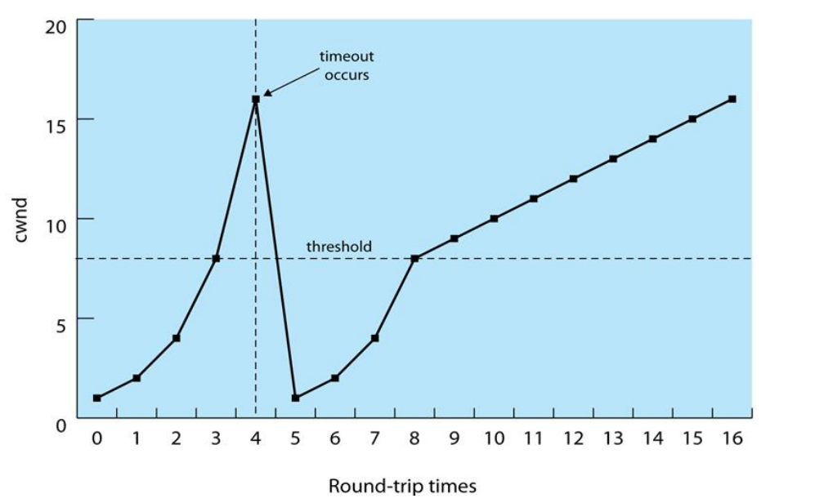
Illustration of Slow Start and Congestion Avoidance

Slide 22
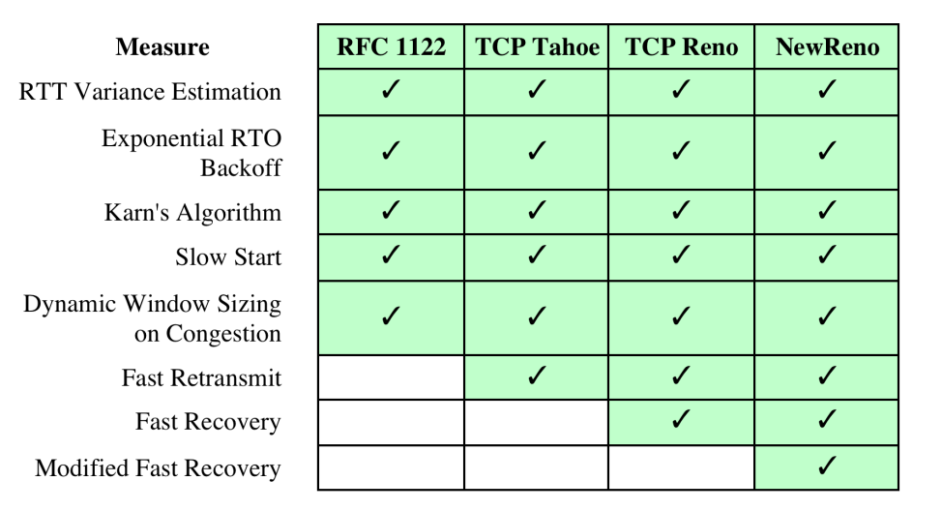
Implementation of TCP Congestion Control Measures

